Slide 1
Agile Training - Level 1
Presented by QMG

Slide 2
Agenda
Introduction to Agile
Why Agile or Need for Agile
Agile Principles
Agile vs. Traditional Approach
Project Constraints
Agile Manifesto/Myths
Agile methods
Scrum
Introduction to scrum
Scrum Roles and Responsibilities
Scrum Work Products
Scrum Planning
Ceremonies in Scrum
XP
Introduction to XP
XP Practices
Implementation of Agile @ Tech Mahindra

Slide 3
Introduction to AGILE

Slide 4
WHAT HAPPENS ??
What happens if the client asks to add new changes after design is all complete
What happens if in midway a developer comes up with an innovative way of doing things
What happens of the competitor is releasing the same kind of product 1 month earlier
What happens if the Competitor has come up with new advanced features
What happens if in between market demands changes
What happens if client’s budget scenario changes in between
What happens if a survey shows the current features are not well accepted in market by users
What happens if the client says this is not what he wanted after its showcased to him
What happens if the priority of requirements changes based on market and users
What happens if in between there is a conflict in understanding of the developers than of the providers
These scenarios reflects the CHANGING TIMES w.r.t. market and user demands
AGILE methodology addresses all the above
Notes:
These are scenarios which can be discussed and audience to be asked how each will be handled in traditional approach.
What impact each statement will have on schedule, effort, cost, time in traditional approach.

Slide 5
Need for Agile
Time to market becoming crucial
Budgets are shrinking
Requirements not clear upfront or being developed concurrently
Agile project management methods like Scrum can be applied to any project effort to deliver improved results in ever evolving business environments, and do so in a manner that demonstrates visible, predictable progress toward today’s most important business priorities.
Agility is the ability to both create and respond to change in order to profit in a turbulent business environment. - Jim Highsmith, Agile Project Management .
Notes:
This emphasizes on the need for Agile in current market scenario.

Slide 6
Sunrise of Agile
In late 1990's several methodologies began to get increasing public attention.
They all emphasized
close collaboration between the programmer team and business experts;
face-to-face communication (as more efficient than written documentation);
frequent delivery of new deployable business value;
tight, self-organizing teams;
and ways to craft the code and the team such that the inevitable requirements churn was not a crisis.
Early 2001 saw a workshop in Snowbird, Utah, USA, where various originators and practitioners of these methodologies met to figure out just what it was they had in common.
They picked the word "agile" for an umbrella term and crafted the Manifesto
Notes:
In February 2001, 17 software developers^{[6]} met at the Snowbird, Utah resort, to discuss lightweight development methods. They published the Manifesto for Agile Software Development^{[1]} to define the approach now known as agile software development. Some of the manifesto's authors formed the Agile Alliance, a nonprofit organization that promotes software development according to the manifesto's principles
The Agile Manifesto was written in February of 2001, at a summit of seventeen independent-minded practitioners of several programming methodologies. The participants didn't agree about much, but they found consensus around four main values.
They also have formed the Agile alliance.

Slide 7
Agile Manifesto
We are uncovering better ways of developing software by doing it and helping others do it. Through this work we have come to value: (www.agilemanifesto.org)
Individuals and Interactions over Processes and Tools
Working Software over Comprehensive Documentation
Customer Collaboration over Contract Negotiation
Responding to Change over Following a Plan
That is, while there is value in the items on the right, we value the items on the left more
Notes:
Emphasizes should be that the things on right will still be there in Agile, but Agile gives more importance to things on left. Things on right forms the basis and project cannot d without them.

Slide 8
Principles behind the Agile Manifesto
Our highest priority is to satisfy the customer through early and continuous delivery
Welcome changing requirements, even late in development
Deliver working software frequently, from a couple of weeks to a couple of months
Business people and developers must work together daily throughout the project
Build projects around motivated individuals. Give them the environment and support they need, and trust them to get the job done.
The most efficient and effective method of conveying information to and within a development team is face-to-face communication
Continuous attention to technical excellence and good design enhances agility
At regular intervals, the team reflects on how to become more effective, then tunes and adjusts its behavior accordingly

Slide 9
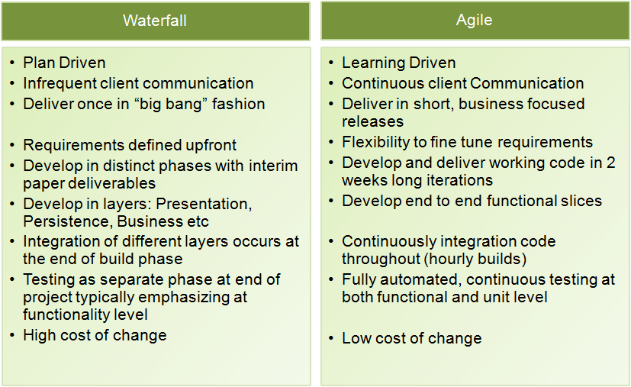
Agile Vs Traditional approach
Notes:
It should be emphasized that showing this difference does not mean waterfall or any other lifecycle methodology is not good. This just shows the difference in 2 approaches.
It’s the way a lifecycle is implemented which is important.

Slide 10
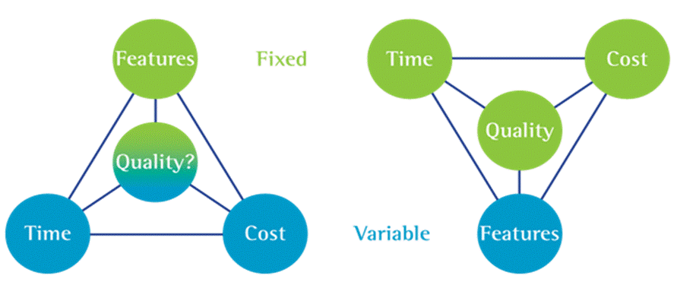
Project Constraints
Traditional Approach
Agile Approach
Time and Cost is variable
Quality at Risk
Focus on Quality
Manage Changes to Features
Deliver Within Time and Cost
Notes:
In Agile- changes in features are easily accepted and incorporated through daily planning, daily meetings, sprit planning etc. In actual scenario there is limitation on cost, time and quality.
Concept of MMS – Minimum Marketable Subset can be explained which tells if there is constraint on time, cost and quality then without compromising on anyone of these a minimum list of prioritized features can be developed which is shippable and working and incorporates minimum functionality for the product to work.

Slide 11
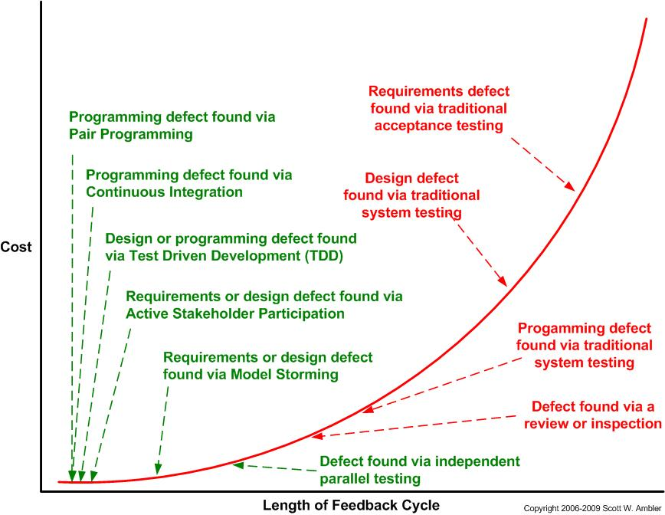
Cost of change curve
Agile
Waterfall
Notes:
This shows cost of change increases if the defect is found in later stages which is negated by use of Agile methods which discovers defects/problems/risks/issues early in lifecycle

Slide 12
Agile Myths
Myth : Implementing Agile is easy
Myth : Agile gives instant benefits
Myth : Agile means no documentation
Myth : Agile means poor quality
Myth : Agile is a silver bullet
Myth : Agile is new
Myth : Traditional delivery never works
Myth : Agile replaces everything that has gone before
Myth : Agile means no planning
Notes:
Silver bullet--- A simple and seemingly magical solution to a complicated problem.

Slide 13
Benefits of Agile
Visibility
Adaptability
Agile
Agile
Satisfaction
Traditional
Traditional
Agile
Risk
Traditional
Agile
Notes:
In particular, agile development accelerates the delivery of initial business value, and through a process of continuous planning and feedback, is able to ensure that value is continuing to be maximized throughout the development process. As a result of this iterative planning and feedback loop, teams are able to continuously align the delivered software with desired business needs, easily adapting to changing requirements throughout the process. By measuring and evaluating status based on the undeniable truth of working, testing software, much more accurate visibility into the actual progress of projects is available. Finally, as a result of following an agile process, at the conclusion of a project is a software system that much better addresses the business and customer needs.
The diagram below displays the differences between agile and waterfall development processes. By delivering working, tested, deployable software on an incremental basis, agile development delivers increased value, visibility, and adaptability much earlier in the life cycle, significantly reducing project risk

Slide 14
Agile Methods
Method | Key Points | Special Features
Scrum | Independent, small, self-organizing development teams, 30-day release cycles. Most used and popular along with XP | Enforce a paradigm shift from the “defined and repeatable” to the “new product development view of Scrum”.
XP | Customer driven development, small teams, daily builds | Refactoring – the ongoing redesign of the system to improve its performance and responsiveness to change
DSDM | Application of controls to RAD, use of time boxing, empowered DSDM teams, active consortium to steer the method development | First truly agile software development method, use of prototyping, several user roles: “ambassador”, “visionary” and “advisor”
RUP | Complete software development model including tool support. Activity driven role assignment | Business modelling, tool family support
Notes:
Dynamic systems development method (DSDM)-DSDM fixes cost, quality and time at the outset and uses the MoSCoW prioritisation of scope into musts, shoulds, coulds and won't haves to adjust the project deliverable to meet the stated time constraint
Rational unified process

Slide 15
SCRUM

Slide 16

History of Scrum
The term Scrum comes from 1986 study by Takeuchi and Nonaka “The New Product Development Game”, published in Harvard Business Review
“The… ‘relay race’ approach to product development…may conflict with the goals of maximum speed and flexibility. Instead a holistic or ‘rugby’ approach—where a team tries to go the distance as a unit, passing the ball back and forth—may better serve today’s competitive requirements.” Hirotaka Takeuchi and Ikujiro Nonaka
In IT context
it is Project Management Methodology for Agile development

Slide 17
Scrum Process Flow
Characteristics of Scrum
Iterative and Incremental
Self Organizing Teams
Product progresses in a series of 2-4 weeks long Sprints
Requirements captured in Product Backlog
Advocates working in small team (7-9)

Slide 18
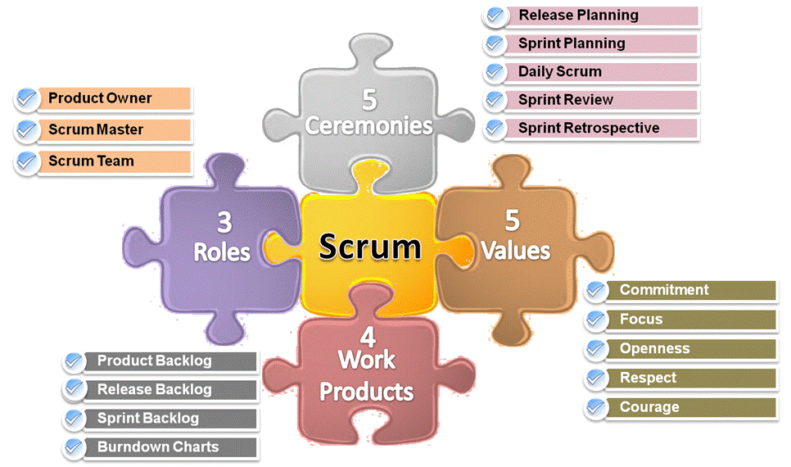
Scrum Components
Notes:
Can explain Scrum of Scrums as well where team is located across locations. Scrum Masters of each location team will have scrum of scrum meetings either daily or once a week.
Values-
Commitment : Be Willing To Commit To A Goal
Focus : Do Your Job, Don’t Worry About Anything Else
Openness : Everything Is Visible To Everyone
Respect : Respect The Different People Who Make Up A Team
Courage : Have The Courage To Commit, To Act, To Cut Out Noise, To Be Open & To Expect Respect

Slide 19
Scrum Values
Commitment : Be Willing To Commit To A Goal
Focus : Do Your Job, Don’t Worry About Anything Else
Openness : Everything Is Visible To Everyone
Respect : Respect The Different People Who Make Up A Team
Courage : Have The Courage To Commit, To Act, To Cut Out Noise, To Be Open & To Expect Respect

Slide 20
Scrum Roles and Responsibilities

Slide 21






Scrum Roles & Responsibilities
Product Owner-
Owns product log and prioritizes
Directs the project, Sprint by Sprint,
Manages ROI through prioritization and release plans
Product Owner
Scrum Master-
Helps the team turn that backlog into functionality
Responsible for enacting Scrum values and practices
Main job is to remove impediments
Fosters team communications
Improves engineering practices and tools
Improving productivity of development team
Organizes and facilitates ‘scrum meetings’
Scrum Master
Scrum Team-
Responsible for managing itself
Has the full authority to do anything to meet the sprint goal
Estimate deliveries
Commit and deliver user stories
Produce quality code
Developers
Testers
+
Product Owner, Scrum Master, Other roles (designer, analyst)
Scrum Team

Slide 22
Scrum Work Products

Slide 23

Product Backlog
Product Backlog
Planning for a Release is done once the Product Backlog is available
Release Planning includes selection of features to be Released in a particular Release
Created by Product Owner with input from other stakeholders
Owned and Prioritized by Product Owner
A Queue of “Stories” (Work Items) for the team
Continuously Evolving
REQ 1
REQ 2
REQ 3
REQ N

Slide 24
Product Backlog …Contd
The product backlog consists of three types of items:
Product functionality - what functions could the system perform to deliver the value anticipated in the product vision.
Non-functional requirements - for the product to deliver the necessary value, what operational aspects must it demonstrate, such as performance, security, reliability, and cost requirements
Environmental requirements - what capabilities and environments must be in place for the product to be developed and delivered

Slide 25


Release Plan
Product Backlog
Release Plan
1st
2nd
3rd
4th
5th
6th
7th
8th
9th
10th
11th
12th
13th
14th
15th
Product Owner chooses Release Plan Features and Release Date for a Release
Prioritizes Features / Outcomes of Release Plan According to Market Value
Adjusts Features / Outcomes and Priority of Release As Needed
Items (tick marks) from Product log (User stories) are selected for a release and then prioritized. Release Plan is a sub-set of Product backlog

Slide 26
Sample Product Backlog / Release Plan
Company Confidential Product Backlog Template ITS-E-T026C I 2.0
 |  | (Can be also used as a Release Backlog for capturing user-stories for a release)
Priority | Item # | User Story / High level Task Description | Effort Estimate | Size Estimate | Release | Iteration no | Business Value | By | Status | Release Date
1 | 1 | US1 - Finish database versioning | 16 | 3 | R1 | I1.0 | 400 | AM | In Progress
2 | 2 | US2 - Get rid of unneeded shared Java in database | 8 |  |  |  | 400 | MK | Pending
 | 3 | US2.1 - Add licensing | 41 | 10 | R1 | I1.0
3 | 4 | US3 - Analysis Manager- Part1 | 410 | 10 | R1 | I2.0 | 300 | AC | Completed
4 | 5 | US4 - Enforce unique names | 57 | 15 | R1 | I2.0 | 200 |  | Dropped
5 | 6 | US5-Admin Programs | 20 | 8 | R1 | I2.0 | 200
6 | 7 | US6-Analysis Manager - Part2 | 40 | 13 | R1 | I2.0 | 100
 | 8 | Task10 - Delete Settings | 15 |  | R1
7 | 9 | US7-Analysis Manager - Part3 | 204 | 17 | R1 | I2.0 | 50

Slide 27

Sprint Backlog
Release Plan
Sprint Backlog 1
1st
2nd
3rd
4th
5th
1st
2nd
3rd
4th
5th
6th
7th
8th
9th
10th
Sprint Backlog 2
11th
12th
13th
14th
15th
6th
7th
8th
9th
10th
Evolves During the Sprint
The List of Tasks Required to Get the Agreed Stories Done
Used As The Detailed Plan And Progress Tracking Mechanism
Source of Progress Information
Should be Publicly Visible
Sprint Backlog 3
11th
12th
13th
14th
15th

Slide 28
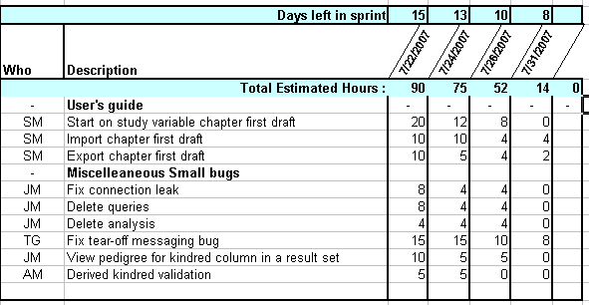
Sample Sprint Backlog

Slide 29
Scrum Planning

Slide 30
Multi-Level Planning
Release Plan
Sprint plan
Daily Plan
Typically Every 3 or 6 Months
Typically Every 2 or 4 Weeks
Daily At Scrum Meetings

Slide 31
Release Planning
Typically every 3 months – A goal and a plan for next release
Stories are allocated to Sprints, based on all relevant factors e.g.:
Business Values → Customer
Size → Team
Risk → Team / Customer
Dependencies → Team
Constraints → Team / Customer
Release Plan is reflected in Product Backlog
Updated continuously – At end of every Sprint at least
Sample Release Plan

Slide 32
Sprint
Sprint Common Length is 2 Weeks or 1 Month, but it can vary from 7 Calendar Days to 30 Calendar Days (i.e. 1 Month) Depending Upon Release Cycle
Each Sprint is Always of Same Duration
Back To Back – No Gaps Between Sprints
Always Creates ‘A Potential Shippable Product Increment’
Could Deliver to ‘Live’, however possibly put into a holding area
Sample Sprint Backlog
7 Days
30 Days
Shorter Release Cycles = Shorter Sprints

Slide 33

Sprint Planning
Strictly Time-Limited Meeting/s … Max Half a Day Total
Draft Sprint Backlog (Stories)
Team Capabilities
Business Conditions
Technology Stability
Retrospective
Facilitate & Time box the Meeting
Sprint Goal
Sprint Backlog
Scrum Master
Explain Goal, Vision & Backlog Items
Product Owner
Plans & Commit to work on Backlog Items
Developers
Testers

Slide 34
Sprint Planning Meeting
The Product Owner
describes highest priority features to the Team.
selects the ideal backlog for the coming sprint and communicates its meaning and importance to team
answers questions but does not direct the team’s choices.
Team
decides what they can commit to delivering in the Sprint.
may ask questions.
decides
on the sprint goal (a short theme for the sprint)
how much it can commit to delivering in the coming Sprint.
The outcome is the Sprint goal and the Sprint Backlog.

Slide 35
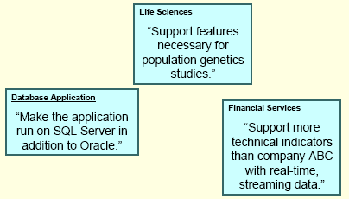
Examples of Sprint Goals

Slide 36
Estimation

Slide 37
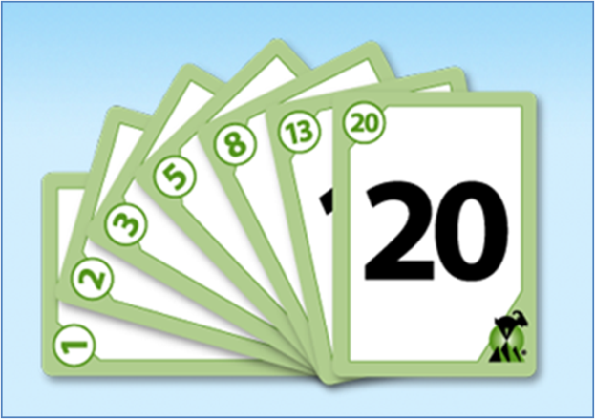
Estimating Size
Traditional and Agile measure size differently
Traditional Measures of Size
Lines of Code
Function Points
Agile Measures of Size
Ideal Time
Story Points
Release are estimated ‘Top-Down’
Experience Based
Generally 2 approaches used-
Ideal days – A Day Without Any Real World Interruptions
Story Points – Relative Estimation – More Popular
Non Numerical comparison not as good

Slide 38
Estimating Size – Ideal Days & Story Points
Ideal Days
Removes the Likely Real World Interruptions
50% - 80% Productive is Common Assumption
Ideal Days are Easy to Explain and Can be used for Longer Term Estimates
But My Ideal Day May Not Be Your Ideal Day
Story Points
The “bigness” of a task
Influenced by:
How hard it is
How much of it there is
Relative values are what is important
A login screen is a 2
A search feature is an 8
Teams can Deliver a Certain Number of Story Points per Sprint
It is Quicker and Easier than Ideal Days

Slide 39
Approaches to Estimation
Estimates are made by a GROUP not an INDIVIDUAL
Use a consistent relative scale
Combine techniques
Expert Opinion
Analogy-
Comparing an un-sized story to previously sized stories
Compare the story to multiple previously sizes stories – not just one
Disaggregation or Decomposition-
Breaking big stories into smaller stories
Goal is to define stories that can fit into single iterations
Planning Poker-
It is a tool to facilitate group sizing
What do you need?
Entire team – including product owner/customer
Deck of planning poker cards with point sizes
Stories

Slide 40
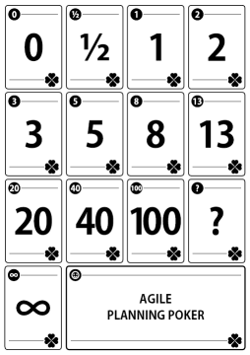
Estimating in Teams: Planning Poker
Poker ‘Cards’ for Each ‘Player’
0, ½, 1, 2, 3, 5, 8, 13, 20, 40, 100, Infinity (Fibonacci-like sequence)
Product Owner Reads a User Story or Describes a Feature
Each player, At The Same Time, shows their Estimate Card
Team Iterates and Discusses Until Consensus Reached
Facilitator Records the Story Point Value
Encourages Discussion, But Prevents Endless Discussion
Particularly Useful for Size Estimating for Release Planning
Less Frequently Used for Estimating Tasks in Sprint Planning

Slide 41
Ceremonies in Scrum

Slide 42
Ceremonies in a Sprint
Sprint Planning |  | Sprint Review | Retrospective Meeting | Sprint Planning
Daily Scrum Meeting

Slide 43
Daily Scrum Meeting
What did you do Yesterday?
.....
What Will You Do Today?
.....
.....
Product Owner
.....
What is Blocking Your Work?
Developers
.....
.....
Scrum Master
Testers
Each Team Member answers 3 Questions
Not a status Reporting Session
Problems are Solved Outside the Meeting
15 Minutes Max (Same Place & Time Each Day)

Slide 44
Scrum of Scrum
Carried out when large teams are broken down into smaller teams
Can be held daily
Purpose is to coordinate activities and address integration issues
Scrum Masters (Team Leaders) of the smaller scrum teams participate
Following is discussed
What did my team do yesterday to advance the objectives of the Sprint
What will my team do today
What are the barriers that could keep my team from meeting its commitment to the Sprint
This meeting takes place after daily SCRUMs

Slide 45
Highly Visible Progress Information - BVC
‘Information Radiator’ or BVC (Big Visible Chart)
Displays Key Information about the project
Anyone can see All Information
Prominently on Walls, Whiteboards, Agile Tools etc.
Typical Contents:
Task Board
Story
Tasks
Task Status
Burndown Chart
Backlogs
Key Information (Risks, Issues, Actions)

Slide 46
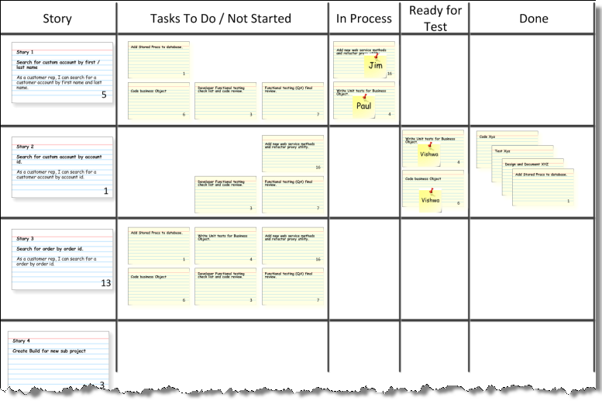
Example BVC of Stories

Slide 47



Definition of DONE (DoD)
Manager – Is the feature you were working on “done”?
Developer - “Yes” ..I checked in the code and had unit tested it…so its “done” from my side.
Manager - Great, then we will go ahead and deploy it into the UAT environment
Developer- But it has not been fully tested by QA, and still need to pass a code review
Manager- Well…….that means its not DONE…..
Root Cause of above “very common ” scenario in Scrum is – there is no common, clear, discussed, agreed upon definition of “Done” for a sprint within the scrum team.

Slide 48

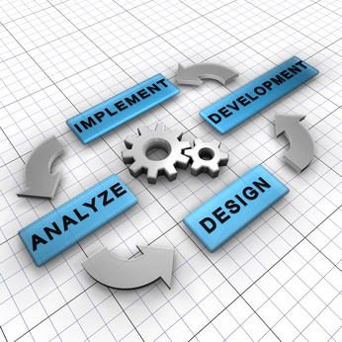
Definition of DONE (DoD)
Definition of DONE (DoD)
Definition of done (DoD) captures activities, that can be realistically committed by the team, to be completed at each level (feature, sprint, release)
DoD is a checklist of valuable activities required to produce software in each sprint
Ideally, potentially shippable is equivalent to the Definition of Done
DoD is orthogonal to user acceptance criteria for a feature
DoD is the primary reporting mechanism for team members.
The DoD is used to validate whether all major tasks are accounted for
Different DoD at various levels:
DoD for a feature (story or product backlog item)
DoD for a sprint (collection of features developed
within a sprint)
DoD for a release (potentially shippable state)

Slide 49
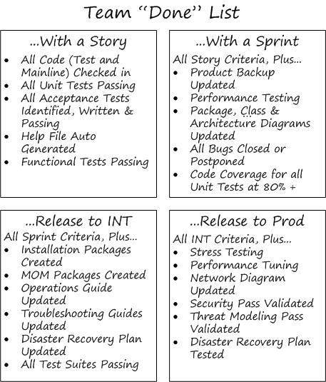
Examples of DoD

Slide 50
Velocity
How many Story Points or Ideal Days of Work can a Team Actually Get ‘DONE’ in a Real Sprint for COMPLETED user stories?
Track the Highest, Average and Lowest over a Time Period
Used to plan Sprints in a Release and to Track the Progress
Not Comparable Across Teams – Teams Develop Their Own Signature
Velocity will typically fluctuate within a reasonable range, which is perfectly fine. If velocity fluctuates widely for more than one or two iterations, the team may need to re-estimate and/or renegotiate the release plan.
Team velocity will typically stabilize between 3 and 6 iterations.
Future iterations use the proven history of the team to determine how much the team can do. Therefore, velocity is the right measure to use for planning future iterations.
Velocity's value comes from its inherent consistency. A fixed iteration length helps drive the reliable rhythm of a project.
Notes:
FAQs:
1.1 Can a user story span multiple iterations? User stories that span multiple iterations are typically release level stories. It is expected that the customer gives them to the project team. But in real life many times the customer hands over the business case (which is not necessarily in the story format) which is then translated into smaller user stories. User story by itself should not be very large and complex. It is advisable to split them up into smaller stories and each story should be delivered in that iteration itself and not span multiple iterations.
1.2 How is velocity calculated? Velocity is the sum of the estimates of planned / delivered (i.e., accepted) features in the form of stories per iteration. Function points or weighted use cases can also be used as a unit of size.
1.3 What unit is used to measure velocity? Velocity is measured in the same units as story estimates, whether this is story points, function points or weighted use cases.
1.4 Why is velocity considered an important metric in agile projects? The importance is due to 2 factors: · Velocity compensates for differences between teams in terms of how big a point is. E.g. let’s assume that project team Alpha and project team Beta are equally efficient in developing software, and they run the same project in parallel. Team Alpha, however, assesses all work items as being worth 3 times as many points. Team Alpha assesses work item A, B, C, and D to correspond to 30 points, and team Beta estimates the same work items to correspond to 10 points. Both teams deliver upon those 4 work items in the next iteration, giving team Alpha a velocity of 30, and team Beta a velocity of 10. It may sound as if team Alpha is more effective, but let’s look at what happens when they plan the next iteration. They both want to take on work item E-H, which team Alpha has estimated to be 30 points, and team Beta as normal has estimated to be 1/3 as many points, or 10 points. Since a team can typically take on as many points as indicated by their velocity, they can both take on all of E-H. The end result is that it does not matter how big a point is, as long as you are consistent within your team. · Velocity also averages out the efficiency of different team members. E.g. let’s assume that Ann always works 3 times as fast as Jack and Jane. Ann will perhaps deliver 9 points per iteration, and Jack and Jane 3 points each per iteration. The velocity of that 3-person team will be 15 points. As mentioned above, Ann and Jack may not agree on how much effort is associated with a work item, but they can agree on how many points it is worth. Since the team velocity is 15, the velocity will automatically translate the point estimate to how much work can be taken on. As you switch team members, or as team members become more or less efficient, your velocity will change, and you can hence take on more or less points. This does however not require you to change the estimate of the size. The size is still the same, and the velocity will help you to calculate how much size you can deliver upon with the team at hand for that iteration.
1.5 How is the first iteration's velocity estimated? While calculating story points and assigning complexity it is advisable to take into account effort required and that should include enough buffer to account for standard project overhead and estimation inaccuracy. Also, remember that velocity will quickly emerge during the first iteration. If underestimated, velocity in the first iteration will rise as new features are included; and if overestimated, velocity will decrease as features are removed. The second iteration should then use the first iteration as a guideline.
1.6 Do meetings, phone calls, email get included in velocity? This depends on whether these items are estimated and included in the iteration plans. If they are a recurring or consistent part of a project e.g. weekly status calls then they need to be accounted for. As an industry norm they are typically not included - a goal of velocity is relative consistency and predictability across iterations in terms of a team's ability to deliver.
1.7 Should velocity be accumulated across teams or projects? Velocity is very much a localized measure. In addition to different team members with different team 'personalities', projects typically possess unique characteristics in terms of estimating techniques, detail process, technology, customer involvement, etc. As a result, this can make organization-wide analysis very inaccurate. If, on the other hand, all of your teams estimate exactly the same, develop exactly the same, test exactly the same, and track exactly the same, then by all means, maybe you are the exception. In TechM projects need to follow the estimation process defined on the BMS so that all projects start using a common scale for arriving at the size and over a period we expect that we would be able to see a trend and compare projects using similar technologies or of a similar nature
1.8 What if velocity fluctuates? Velocity will typically fluctuate within a reasonable range, which is perfectly fine. If velocity fluctuates widely for more than one or two iterations, the team may need to re-estimate and/or renegotiate the release plan.
1.9 How long does it take for velocity to stabilize? Team velocity will typically stabilize between 3 and 6 iterations. But productivity which is velocity/efforts is the derived metric one needs to monitor over iterations since it is irrespective of any team size changes
1.10 How do I to estimate future iterations? Future iterations use the proven history of the team to determine how much the team can do. Therefore, velocity is the right measure to use for planning future iterations.
1.11 How do I estimate velocity if project teams change size? Velocity relies on team consistency in order to be most valuable. If a team changes, use common sense in planning future iterations. If 20% of your team is unavailable for a couple iterations, then reduce planned velocity by 20% or so. If this includes a couple of key players, in particular a customer that may be less available, then reduce the estimate a little more. It will only take the length of the next iteration to understand better what the team can deliver and thus their new velocity.
1.12 Does maximum velocity mean maximum productivity? Absolutely not. In an attempt to maximize velocity, a team may in fact achieve the opposite. If asked to maximize velocity, a team may skimp on unit or acceptance testing, reduces customer collaboration, skip fixing bugs, minimize refactoring, or many other key benefits of the various agile development practices. While potentially offering short-term improvement (if you can call it that), there will be a negative long-term impact. The goal is not maximized velocity, but rather optimal velocity over time, which takes into account many factors including the quality of the end product.
1.13 How do we measure velocity if our iteration lengths change? You don't, at least not nearly as easily. Velocity's value comes from its inherent consistency. A fixed iteration length helps drive the reliable rhythm of a project. Without this rhythm, you are constant revising, re-estimating, and reconciling, and the ability to predict out in the future is minimized due to inconsistent results. If, on the other hand, almost everyone is going to be out a week for the holidays or a couple days for company-wide meetings, then by all means simply use common sense and adapt iteration dates or velocity accordingly. Like most agile practices, these are guidelines, not rules that are meant to prevent common sense.

Slide 51
Release Planning based on Team Velocity
Estimate and Allocate Stories to Sprints According to Priority
Leave Hardening Sprint Empty Initially
Do Not Plan to Exceed Team Velocity
Use Previous Team Velocity, if known
OR if Team Velocity is Unknown, Estimate it by
Calculating and Extrapolating Assumed Velocity from a Few Stories
OR Using Commitment-Based Planning of a Full Sprint
Notes:
Hardening Sprint / Regression Sprint/ Release Sprint
The most successful agile teams have implemented a sprint that, in effect, is specifically designed and tailored to just test, or quite simply a “testing sprint¨. Although this testing or integration sprint can go by many names, a regression sprint or hardening sprint are the most common types. Prior to releasing to the customer, usually, someone has to do security, performance, accessibility, usability, scalability, perhaps localization, or many other types of tests that are most effectively done once the product is fully integrated. In most cases, this is when end-to-end, workflow, user-scenario tests are done and when full regression suites are executed. It is a great bug-finding and confidence-building sprint. But! Its late into the development cycle. “Bugs¨ found here may go directly into the backlog for the next release or cause a feature to be pulled from a release.

Slide 52
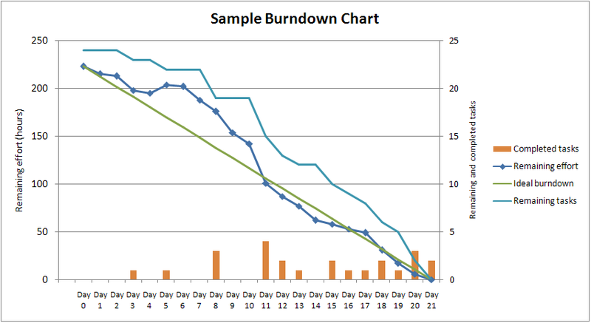
Burndown Chart
Can be used for Projection

Slide 53
Burndown Chart
Each task contains the amount of work remaining
These values are updated continuously
Plot the amount of work remaining across time
Even though you might think that work remaining should always go down, new work is always being discovered as the project is being built
Expect the work remaining to go up and down.
Since the team will be aiming to hit the number zero, the Burn Down chart is emotionally powerful
We get exciting about completing our work and seeing the chart tend toward zero

Slide 54
Sprint Review
Brief demo given by the Scrum Team of everything that has been ‘DONE’ in the sprint OR the product increment
To Product Owner, Requirements Manager and other stakeholders
Time boxed to one hour of prep and four hours of meeting.
Minimal Preparation Should be Required e.g. No PowerPoint
Primary Purpose is Acknowledgement of Achievements
A Natural Progression of the Work of the Sprint
Product Owner ‘Sign Offs’ Sprint if all tests are ‘Green’
Informality is encouraged.

Slide 55
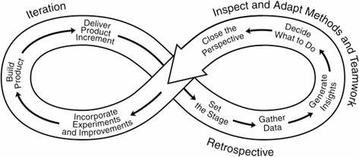
Sprint Retrospective Meeting
Short Structured Workshop Session for Team to Ascertain Lessons & Actions to be Taken into the Next Sprint
Agreed actions are incorporated into Next Sprint Backlog
Longer Retrospectives should be performed at the end of Release

Slide 56
The Sprint Retrospective
A retrospective is a ritual gathering of a community at the end of a project to review the events and learn from the experience
Time boxed to three hours.
Team, Scrum Master, and (optionally) Product Owner review the last Sprint
Teams get together to discuss the following
What did we do well
What did we learn
What should we do differently the next time
What still puzzles us
Actionable items are presented to the Product Owner for prioritization as non-functional requirements.

Slide 57
XP- Extreme Programming

Slide 58

What is Extreme Programming ?
XP is an agile engineering methodology, focused on delivering usable software iteratively in projects that are expected to change as time goes on. XP is geared toward integrating new requirements as they become known, and ensuring that the quality of the new code written to fulfill those requirements remains high.
XP takes commonsense principles and practices to extreme levels

Slide 59
What is difference between Scrum & XP?
Scrum is more high level, focusing on the management of the project (e.g. the requirements or features are managed) rather than specifying or defining engineering practice such as pair programming or test driven development
The length of an iteration in XP is usually 1-3 weeks whereas, in Scrum sprints are 1-4 weeks
Once sprint (or iteration in XP) starts, customer cannot change the requirements, in other words the customer will have to wait until the sprint (or iteration in XP) finishes. In XP however, requirements can change anytime
In XP features are developed in a strict order whereas in Scrum, the team is free to choose the features to be developed. Sequence does not matter
Both define the role of a coach, In Scrum it is called Scrum Master and requires (or strongly recommended) certification, whereas, XP defines the role of coach quite informally and the role may float between members of the team.
Scrum and XP are often used together: Scrum defines the framework and XP defines the engineering practices and they fit together nicely.
Notes:
Added taking reference from CSM material

Slide 60
XP Values
XP is based on 5 core values:
Simplicity - We will do what is needed and asked for, but no more. We will take small simple steps to our goal and mitigate failures as they happen.
Communication - Everyone is part of the team and we communicate face to face daily. We will work together on everything from requirements to code. We will create the best solution to our problem that we can together. Feedback - We will take every iteration commitment seriously by delivering working software. We demonstrate our software early and often then listen carefully and make any changes needed.
Respect - Everyone gives and feels the respect they deserve as a valued team member. Everyone contributes value even if it's simply enthusiasm. Developers respect the expertise of the customers and vice versa.
Courage - We will tell the truth about progress and estimates. We don't document excuses for failure because we plan to succeed.

Slide 61
Rules of XP
Planning –
User stories are written.
Release planning creates the release schedule
Make frequent small releases
The project is divided into iterations
Iteration planning starts each iteration
Managing –
Give the team a dedicated open work space
Set a sustainable pace
A stand up meeting starts each day.
The Project Velocity is measured.
Move people around
Fix XP when it breaks.
Designing –
Simplicity
No functionality is added early
Refactor whenever and wherever possible.
Notes:
Above are the XP rules around basic Engg practises/activities followed in any development project
Keep the system uncluttered with extra stuff you guess will be used later. Extra functionality will always slow us down and squander our resources. Keeping your code ready for unexpected changes is about simple design. Adding extra flexibility beyond what you need now always makes a design more complex.

Slide 62
Rules of XP
Coding –
The customer is always available
Code must be written to agreed standards
Code the unit test first
All production code is pair programmed
Only one pair integrates code at a time
Integrate often
Set up a dedicated integration computer
Use collective ownership
Testing
All code must have unit tests
All code must pass all unit tests before it can be released.
Notes:
One of the few requirements of extreme programming (XP) is to have the customer available. Not only to help the development team, but to be a part of it as well. All phases of an XP project require communication with the customer, preferably face to face, on site. It's best to simply assign one or more customers to the development team.
You create one test to define some small aspect of the problem at hand. Then you create the simplest code that will make that test pass. Then you create a second test. Now you add to the code you just created to make this new test pass, but no more! Not until you have yet a third test. You continue until there is nothing left to test. The code you will create is simple and concise, implementing only the features you wanted

Slide 63
XP Process flow
User stories
values
Simple design
Spike solutions
acceptance test criteria
prototypes
Iteration Plan
Planning
Design
refactoring
Coding
Test
Release
(Software increment-
Pair
project velocity
Programming
computed)
Unit test
Continuous
Acceptance testing
integration

Slide 64
XP Roles
Customer
Writes User Stories and specifies Functional Tests
Sets priorities, explains stories
May or may not be an end-user
Has authority to decide questions about the stories
Programmer
Estimates stories
Defines Tasks from stories, and estimates
Implements Stories and Unit Tests
Coach
Watches everything, sends obscure signals, makes sure the project stays on course
Helps with anything
Tracker
Monitors Programmers’ progress, takes action if things seem to be going off track.
Actions include setting up a meeting with Customer, asking Coach or another Programmer to help

Slide 65
XP Roles contd
Tester
Implements and runs Functional Tests (not Unit Tests!)
Graphs results, and makes sure people know when test results decline.
Doomsayer
Ensures that everybody knows the risks involved
Ensures that bad news isn't hidden, glossed over, or blown out of proportion
Manager
Schedules meetings (e.g. Iteration Plan, Release Plan), makes sure the meeting process is followed, records results of meeting for future reporting, and passes to the Tracker
Possibly responsible to the Gold Owner.
Goes to meetings, brings back useful information
Pays for pizza
Gold Owner
The person funding the project, which may or may not be the same as the Customer

Slide 66
User Stories
Basic Unit of Scope – WHO, WHAT and WHY
Describes the Customer’s View of Value
A start-point from which to collaborate rather than an assumed contracted requirements
Captures High Level Acceptance Criteria
Complete story consists of ‘3 Cs’
Card - short hand physical token of planning and management
Conversation - between customer and developer about the detail
Confirmation - through predefined acceptance criteria and tests
Stories are created by Product Owner supported by Scrum Master and Team
Notes:
Theme – A Theme is a top-level objective, a set of related User Stories.
Epic- A group of related User Stories or a large User Story, generally too big to fit into a single Sprint.
A User Story is an Independent, Negotiable, Valuable, Estimatable, Small, Testable requirement that can be associated with one ore more themes.
Any story that belongs to more than 2 themes generally is overkill.
You can use “Releases” as themes.
The terms Epic and Theme are really only most useful during high level planning like road mapping
and Release Planning.
Which means they are generally most useful to the PO and stakeholders, and less useful to the Development Team.
It is sometimes easier for stakeholders to discuss and help prioritize stories at the Epic and Theme level
The card contains little information and is often written in the form “As A <<Role Name>> I want <<a feature>> so that <<some value delivered>>”. There are many different forms that this can take, but what is most important is that what is written, is meaningful to the team delivering the feature and the customer (or product owner) requesting it. Developers cannot write software from the card alone and to that end they need the next part … the conversation.
The conversation is the essence of the requirement and conversations can spawn many outputs or artefacts such as models, notes, story maps or even good old fashioned code
The confirmation (often written on the back of the story card) gives us the high-level criteria against which the resulting feature will be tested against.

Slide 67
Story Card - Example
Iteration:
Story ID:
Estimate:
Acceptance Criteria
Story Summary:
Search for Providers By Provider Specialty
The provider search mechanism has the ability to enter a specialty
As a
Provider Search User
The specialty search will have a list of provider specialties from which to select
Searching via the provider specialty will return a list of matching specialists or a message indicating that there are no matches
the ability to search for providers by specialty
I want
I can more efficiently refer patients
So that
If there are more results than can fit on one page, the system will provide the capability to view the list in pages or sections
to specialists
1
2

Slide 68
Writing Good User Stories - INVEST
Independent – of Each Other
Negotiable – the Start Point for Collaboration not a ‘contract’
Valuable – to the Customer / Purchaser
Estimable – Able to be Estimated
Small Enough – 1-5 Days Effort for Sprint Level Stories
Testable – Every Story Must Be Testable
Notes:
Good user story should be the following
Independent The user story should be self-contained, in a way that there is no inherent dependency on another user story. N Negotiable User stories, up until they are part of an iteration, can always be changed and rewritten. V Valuable A user story must deliver value to the end user. E Estimable You must always be able to estimate the size of a user story. S Sized appropriately or Small User stories should not be so big as to become impossible to plan/task/prioritize with a certain level of certainty. T Testable The user story or its related description must provide the necessary information to make test development possible

Slide 69
Other Story Tips
Merging Small Stories
Story Size of 1-5 days is best
Team will sometime list all ‘tasks’ as stories’
E.g. “10 Min Stories” – Not Good
Re-Group these tasks into Stories of 1-5 Days
This is not a ‘Hard & Fast’ Rule
Don’t do task breakdown until Sprint Planning
Ensure the people who are to develop the story, understand the story
Team should expect to spend approx 5% - 10% of each sprint helping to ‘GROOM’ the stories for the next sprint

Slide 70
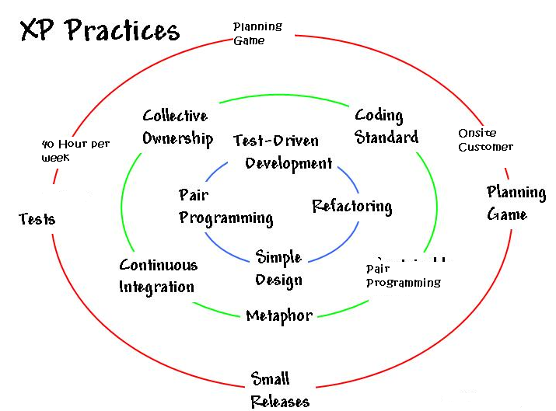
XP : 12 Practices
The Planning Game
Small Releases
Metaphor
Simple Design
Testing
Refactoring
Pair Programming
Collective ownership
Continuous integration
40-hour week
On-site customer
Coding standards
Notes:
The Planning Game — Quickly determine the scope of the next release by combining business priorities and technical estimates. As reality overtakes the plan, update the plan.
Small releases — Put a simple system into production quickly, then release new versions on a very short cycle.
Metaphor — Guide all development with a simple shared story of how the whole system works. Comparison of 2 unlikely things e.g. life is a journey.
Simple design — The system should be designed as simply as possible at any given moment. Extra complexity is removed as soon as it is discovered.
Testing — Programmers continually write unit tests, which must run flawlessly for development to continue. Customers write tests demonstrating that features are finished.
Refactoring — Programmers restructure the system without changing its behavior to remove duplication, improve communication, simplify, or add flexibility.
Pair programming — All production code is written with two programmers at one machine.
Collective ownership — Anyone can change any code anywhere in the system at any time.
Continuous integration — Integrate and build the system many times a day, every time a task is completed.
40 hour week — Work no more than 40 hours a week as a rule. Never work overtime a second week in a row.
On-site customer — Include a real, live user on the team, available full-time to answer questions.
Coding standards — Programmers write all code in accordance with rules emphasizing communication through the code.

Slide 71
XP Practices
The Planning Game
Quickly determine the scope of the next release by combining business priorities and technical estimates. As reality overtakes the plan, update the plan.
Small Releases
Every release must be as small as possible
Contain the most valuable business requirements
Release has to make sense
Collective ownership
Anyone can change any code anywhere in the system at any time.
Metaphor
Put a simple system into production quickly, then release new versions on a very short cycle.
Notes:
Though XP has 12 Practices, TechM has adopted 6 basic practices for Agile Implementation @ TechM and among the same practices have been explained in detail here. The most common practices followed are:
Small Releases
Continuous Integration
Refactoring
Coding Standards
Planning Game
Pair-Programming.
Pair-Programming is followed only when there are new members in the team so that they get on-the-job experience.

Slide 72
XP Practices
Pair programming
All production code is written with two programmers at one machine.
Continuous Integration
Code is integrated and tested after a few hours
Daily builds are for wimps
Build, end to end, at every check in
Check in frequently
Put resources on speeding build time
Put resources on speeding test time
Reduces project risk:
You’ll never spend days chasing a bug that was created some time in the last few weeks
Provides valuable human benefit during development
Notes:
Though XP has 12 Practices, TechM has adopted 6 basic practices for Agile Implementation @ TechM and among the same practices have been explained in detail here. The most common practices followed are:
Small Releases
Continuous Integration
Refactoring
Coding Standards
Planning Game
Pair-Programming.
Pair-Programming is followed only when there are new members in the team so that they get on-the-job experience.

Slide 73
XP Practices
Simple design
The system should be designed as simply as possible at any given moment. Extra complexity is removed as soon as it is discovered.
40 hour week
Work no more than 40 hours a week as a rule. Never work overtime a second week in a row.
Testing
Programmers continually write unit tests, which must run flawlessly for development to continue. Customers write tests demonstrating that features are finished.
On-site customer
Include a real, live user on the team, available full-time to answer questions.
Notes:
Though XP has 12 Practices, TechM has adopted 6 basic practices for Agile Implementation @ TechM and among the same practices have been explained in detail here. The most common practices followed are:
Small Releases
Continuous Integration
Refactoring
Coding Standards
Planning Game
Pair-Programming.
Pair-Programming is followed only when there are new members in the team so that they get on-the-job experience.

Slide 74
XP Practices
Refactoring
Refactoring is a disciplined technique for restructuring an existing body of code, altering its internal structure without changing its external behavior.
Meaning of word Factoring
2
x − 1 can be factored as (x − 1 ) (x + 1)
What have we done ? We have simplified further
In software refactoring it means
Rejuvenating old designs
Removing redundancy
Eliminating unused functionality
We cannot check in our code until:
All tests are green.
All duplication has been removed.
The code is as expressive as we can make it

Slide 75
XP Practices
Coding Standards
Consensus of coding style and practices
Contributes to definition of clean code and “doneness”
Goal is that code looks anonymous
All code should look the same
It should not possible to determine who coded what based on the code itself
Constraints
System should have the fewest possible classes
System should have the fewest possible methods
Comments should be minimized

Slide 76

Pair Programming
2 people work together at one PC to create a code for a story
One person types and thinks tactically about the method being created
Other thinks strategically about how that method fits into the class

Slide 77
Pair programming - Concerns
Productivity will be halved
With collective code ownership, it will be difficult for programmers to be recognized and compensated
It is annoying having someone looking over your shoulder while you program
Pair programming will interfere with "flow", which requires solitude and silence
But what has been observed …..

Slide 78
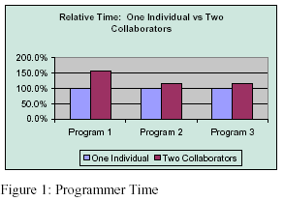
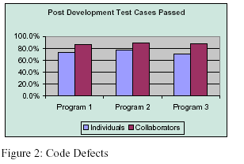
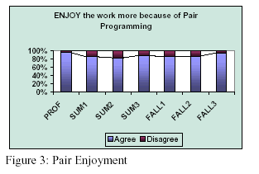
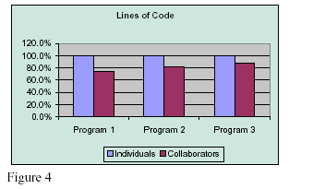
Pair programming – Success trends
Lesser than double Efforts
High Quality
People enjoy working in pairs
Lesser LOC

Slide 79
Pair programming-Take Care…

Slide 80
Stages of an XP project
Initiation
User Stories
Release Planning
Release (each Release is typically 1 - 6 months)
Iteration 1 (typically 1 - 3 weeks)
Development
Deployment
Acceptance Testing
Iteration 2
Development
Deployment
Acceptance Testing
:
Iteration n

Slide 81
Advantages of XP
Customer focus increases the chance that the software produced will actually meet the needs of the users
The focus on small, incremental release decreases the risk on your project:
by showing that your approach works and
by putting functionality in the hands of your users, enabling them to provide timely feedback regarding your work.
Continuous testing and integration helps to increase the quality of your work
XP is attractive to programmers who normally are unwilling to adopt a software process, enabling your organization to manage its software efforts better.

Slide 82
Disadvantages of XP
XP is geared toward a single project, developed and maintained by a single team.
XP is particularly vulnerable to "bad apple" developers who:
don't work well with others
who think they know it all, and/or
who are not willing to share their "superior” code
XP will not work in an environment where a customer or manager insists on a complete specification or design before they begin programming.
XP will not work in an environment where programmers are separated geographically.
XP has not been proven to work with systems that have scalability issues (new applications must integrate into existing systems).

Slide 83
Implementation @ Tech Mahindra

Slide 84
Agile Implementation
Days
-15
T0
30
60
90
180
Hot
House
Release 1
Planning
Release 2
Planning
Prioritised Business
Scenarios/User Stories
Business Delivery Plan
Release 1 (90 days)
Release 2 (90 days)
Iteration
Iteration
Iteration
Iteration
Iteration
Iteration
Iteration
Iteration
Iteration
Iteration
Iteration
Iteration
Iteration
Iteration
Iteration
Iteration
Iteration
Iteration
DAY
0
10
1
2
3
4
5
6
7
8
9
10
Sprint or
Iteration
Planning
Sprint
planning
Retro-
spective

Slide 85
Agile Methodology
Scrum as project management methodology
Some of the XP practices will be adopted
Highlights
90 day release cycle
2 week sprint (iteration) (can be tailored)
Pre-90 days
Hot housing
Release
Iteration 0
Iteration 1 to (n-1)
Iteration n

Slide 86
Pre – 90 days
Objective – To finalize product vision
Nothing to start with
Process Owner – Delivery Manager
Inputs
Tasks
Conduct Hot House
Define high level requirements
Define Minimum E2E solution design
QG 1
Tech Mahindra Process
Hot Housing Guidelines
Outputs
High level Requirements document
High level design or solution architecture
Quality Gates
Approval of high level requirements & design from customer
QG 1
Notes:
70

Slide 87
Iteration 0
Process Owner – Scrum Master
Objective – To plan for release
Inputs
High level requirements
High level design or solution architecture
Release and Project Planning
Development and Testing Environ setup
Mobilize resources and infrastructure
Tasks
Detail out user stories or use cases for next iteration
Enhance design document
Establish coding standards
QG 2
Tech Mahindra Process
Project plan template for Agile
SCRUM guidelines document
Use case template
User story template
Release management process
Outputs
Project Plan
Release Plan/Product backlog
Enhanced design
User stories for next iteration
Coding standards
Quality Gates
Approval of Project plan and Release plan (product backlog)
QG 2
Notes:
70

Slide 88
Iteration 1- (n-1)
Process Owner – SCRUM Master
Objective – Plan and monitor sprint/iteration
Inputs
Release Plan/ Product backlog
User stories or use cases for iteration
Enhanced design document
Explain user stories
Develop and test user stories
Continuous building
Integration testing
Tasks
Sprint/
Iteration planning
Project Monitoring & progress reporting
Scrum meetings
Plan for next sprint/ iteration
Show and tell Retrospective
Update product backlog
QG 3
Tech Mahindra Process
Product & Sprint backlog
template
Sprint burn down template
Iteration metric sheet
Scrum guidelines
Template for Retrospective
Outputs
Project burndown chart
Tested product increment
User stories for next iteration
Enhanced Design
Updated Iteration Metric
Action points from Retrospective
Quality Gates
Project burndown chart, Iteration metric sheet updated for iteration data
Code walkthrough, Test logs
QG 3
Notes:
70

Slide 89
Iteration n - The stabilization sprint
Prepares the developed product for final release
Update final documentation
Pre-release testing
Regression testing
System/Integration testing
Retrospectives
Prepare for the next release

Slide 90
Agile Development Practices @ TechM
Structured
Processes
Agile Development Practices @ TechM
SCRUM
XP
Requirement Analysis
Customer Collaboration
Hot Housing / Story Definition
System and Software Design
Release Planning
Use Cases / Architecture Definition
UML based modeling
Coding and Unit Testing
Iterative development
Retrospectives
Continuous Integration
Daily Stand Ups
Re-factoring
Integration and System Testing
Planning Game
Small releases
Coding standards
Operations & Maintenance
Pair-Programming
Project Management
Risk Management
Change Management
Governance models
Issues Management
Communication Model Collaboration Tools
Processes for each iteration / phase
Notes:
A blend of both Scrum and XP has been used for the Agile Implementation @ TechM.

Slide 91
Agile Metrics at TechM
S. No | PARAMETERS
1 | On Time Delivery?
2 | Effort Variance (EV)%
3 | Schedule Variance
4 | Dev Productivity (USP/UCP/FP per PM)
5 | Dev Productivity (Hrs per USP/UCP/FP)
6 | Baselined Productivity (USP/FP/UCP per PM)
7 | Overall Productivity (USP/FP/UCP per PM)
8 | Wtd. Defect Density
9 | Non Wtd. Defect Density
10 | Wtd. DRE (CST)%
11 | Non Wtd. DRE (CST)%
12 | Wtd. DRE (CIT)%
13 | Non Wtd. DRE (CIT)%
14 | Wtd DRE (SIT/NBT)%
15 | Non Wtd DRE (SIT/NBT)%
16 | Wtd. DRE (E2E Testing)%
17 | Non Wtd. DRE (E2E Testing)%
18 | Wtd. Field Defect Density
19 | Non Wtd. Field Defect Density
20 | Velocity variance
Metrics report template for agile Development and Enhancements is available in BMS.

Slide 92
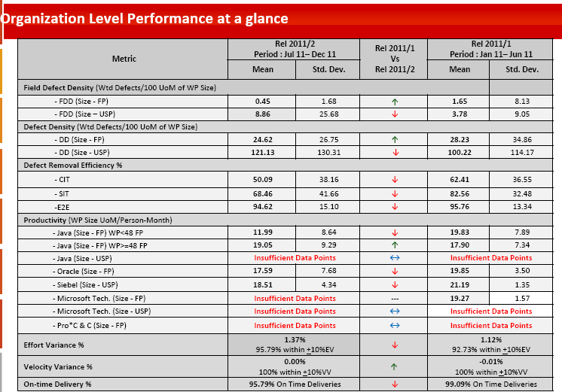
Agile PPB at TechM
Based on the Metrics reports provided by projects, Metrics council will analyze the reports at Org level and Process performance Baselines (PPB) are published once in six months. The PPBs are available in BMS.
PPB Link

Slide 93
Key Agile Artifacts in BMS
Sr # | Artifact | BMS Link
1 | Agile Kit for PM | ITS-E-G006A
2 | Agile Estimation Procedure | ITS-E-P001A
3 | Product Backlog Template | ITS-E-T026C
4 | User Story Template | ITS-E-T036A
5 | Sprint Backlog and Burn down | ITS-E-T026D
6 | Scrum Guidelines | ITS-S-G007I
7 | Agile Guidelines | ITS-S-G007H

Slide 94


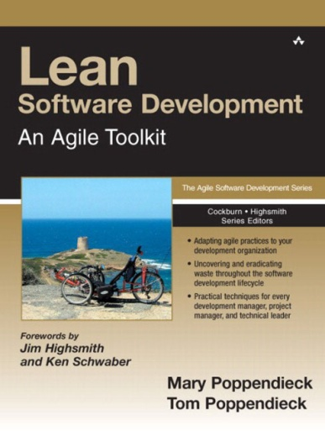

Recommended Books
Agile Software Development with Scrum
Ken Schwaber and Mike Beedle
Agile Project Management with Scrum
Ken Schwaber and Mike Beedle
User Stories Applied
Mike Cohn
Lean Software Development
Mary Poppendieck

Slide 95
Recommended Websites
www.agilealliance.com
www.mountaingoatsoftware.com
www.controlchaos.com

Slide 96
Document History
Version No | Date | Author | Reviewed By | Approved By | Reason and Nature of Change
1.0 | 07-Apr-2008 | Vishnu Kiumar Prasad |  | Simmi Dhamija | First Issue
2.0 | 27-Dec-2012 | Puja Nigam Sanjaya Kumar | QMG Agile Task Force: Ashish Gupta Ashwini Chaudhari Saurabh Singh Shalini Joshi Shivani Tongaonkar, Madhuri Kenjale | Amita Rege | Changes done: Overall presentation of contents in the slides Estimation approach/methods Definition of DONE INVEST approach for User story writing Multi level planning Velocity tracking Hardening Sprints Planning Pyramid Roles &Responsibilities Impact on project constraints in traditional and Agile methodology Elaborated Release planning Highly Visible Progress Information – BVC. Rules of XP XP Values XP- Advantages and Disadvantages Metrics @ TechM BMS references
2.1 | 27th May’13 | QMG Agile Task Force | Shalini, Ashwini | Amita Rege | Changes done as per suggestions received during 1st training session.

Slide 97


Slide 98
Annexure
Notes:
Extra slides for trainer..

Slide 99


Cone of Uncertainty
Agile Way
Traditional Way
Detailed Design Complete
Requirement Complete
Approved Product Definition
Software Complete
UI Design Complete
Cone of Uncertainty
Initial Concept

Slide 100
Planning Poker Tips
Story Point:
0 → Already Done
½, 1 → If any story is simpler than the story having point 2
2, 3, 5, 8, 13, 20, 40, 100 → Story points as per complexity
Infinity → Cannot be Done
? → I don’t know

Slide 101

Planning Pyramid
Features / Requirements / Stories / Epics
Stories
Epics
Themes

Slide 102
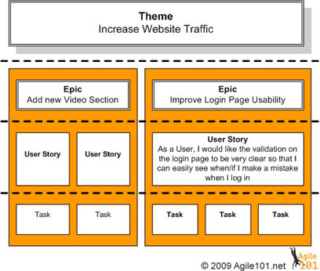
Planning Pyramid
Theme – A Theme is a top-level objective, a set of related User Stories.
Epic- A group of related User Stories or a large User Story, generally too big to fit into a single Sprint.
A User Story is an Independent, Negotiable, Valuable, Estimatable, Small, Testable requirement that can be associated with one ore more themes.
Any story that belongs to more than 2 themes generally is overkill.
You can use “Releases” as themes.
The terms Epic and Theme are really only most useful during high level planning like road mapping
and Release Planning.
Which means they are generally most useful to the PO and stakeholders, and less useful to the Development Team.
It is sometimes easier for stakeholders to discuss and help prioritize stories at the Epic and Theme level

Slide 103
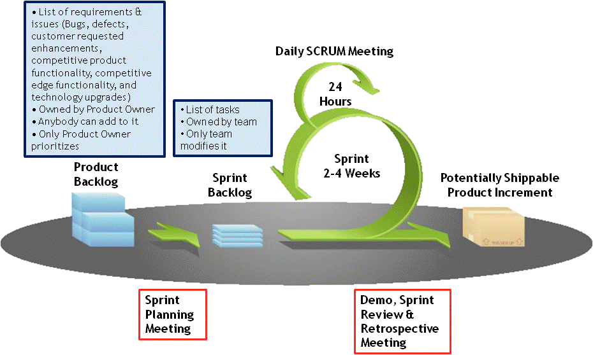
Scrum Development

Slide 104
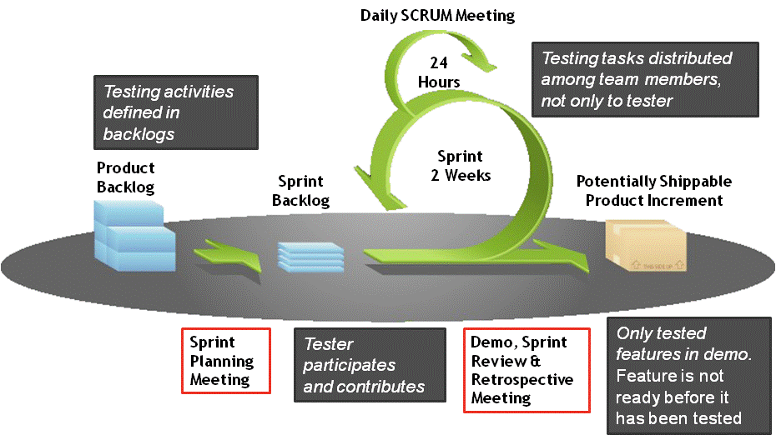
Scrum Testing Methodology

Slide 105



Generic Approach
Sprint 1
Sprint 2
Sprint…
Outline Analysis, Solution, Plan
Plan, Analysis
Design
Build Test
Sprint 0
Working
Solution
Metrics,
Lessons
Every
Iteration
Sprint : Typically Every 2-4 Weeks
Self Organizing Cross Functional Team including Customer Representative

